Slide 1
The ‘CalFresh Application Experience Project’ A project by the SF-Marin Food Bank
November 2015
www.transformcalfresh.org
Notes:
Jenn/Sarah
Welcome everyone to the ATC webinar on the calfresh application experience! I’m Jennifer Tracy and I’ll be hosting this webinar this morning, along with Sarah LN and Stephanie LN.
This is a continuation of our webinar series in identifying barriers and solutions to improving access to CalFresh.
We have XX people signed up for this webinar.
We represent XY counties and other states (?)
I’m going to briefly introduce ATC, and then will introduce our webinar and webinar leaders

Slide 2
Reduce Hunger in CA
Goal: California is a top 10 state for CalFresh access, with at least 75% of eligible people participating by 2016, per USDA.
How? Advance 3 data-driven strategies for customer service that improve participation, in partnership with counties and the State.
Quick: Same Day Service
Consistent: Zero Churn
Connected: One Stop for Medi-Cal & CalFresh
Notes:
Jenn/Sarah
Before we move into SF Marin’s presentation, a little background on ATC. We were founded in 2011 with seven members with a goal of becoming a top 10 state with at least 75% participation rate.
Our approach has focused on being data-driven and using data to inform our understanding of both gaps in service and promising practices. We’re focused on customer service and the outcomes of connecting people with CalFresh.
To that end, we have identify some key strategies:
making sure access to CF is *quick* by promoting and supporting same day service options
We want access to be *consistent* with people being able to maintain their benefits and not having to go through the churning of reapplication.
And we want people to be easily and quickly connected, by ensuring dual enrollment between Medi-Cal and CalFresh.
Our webinar today highlights aspects of all of these goals.

Slide 3
Today’s Webinar:
The ‘CalFresh Application Experience Project’:
Project overview
Participant characteristics/outcomes
Key observations/recommendations
Next steps
Lessons learned
Collaboration:
How projects like this can be used by the County
Examples of outcomes and innovations
Notes:
Jenn/Sarah
Today’s webinar is going to review the project initiated by SF Marin Food Bank, with an overview of how the project was set up, the participants that were recruited, what was learned from the project and some next steps.
We’ll also be covering how the findings from this project could inspire innovative ways to engage and create improvements in your own counties.
And we’ll have some time for Q&A at the end.
You should have, on the side bar of the webinar, a place to enter your questions throughout the webinar.

Slide 4
Introductions
Jennifer Tracy, ATC Consultant
Becky Gershon, SF-Marin Food Bank
Diana Jensen, SF-Marin Food Bank
Tiana Wertheim, San Francisco Human Services Agency
Notes:
Jenn/Sarah
Becky Gershon, who is the Policy and Advocacy Director for SF Marin Food Bank and has a lot of experience in anti-hunger work including community focused research.
Diana Jensen, who is the Policy and Advocacy Senior Analyst for SF Marin Food Bank and has an extensive background in policy work and high level analysis for social service programs, including research and data visualization.
And we’ll also hear from Tiana Wertheim, Analyst with SFO Human Services.
So without further ado, I’ll hand things over to … Becky?

Slide 5
Poll questions!

Slide 6
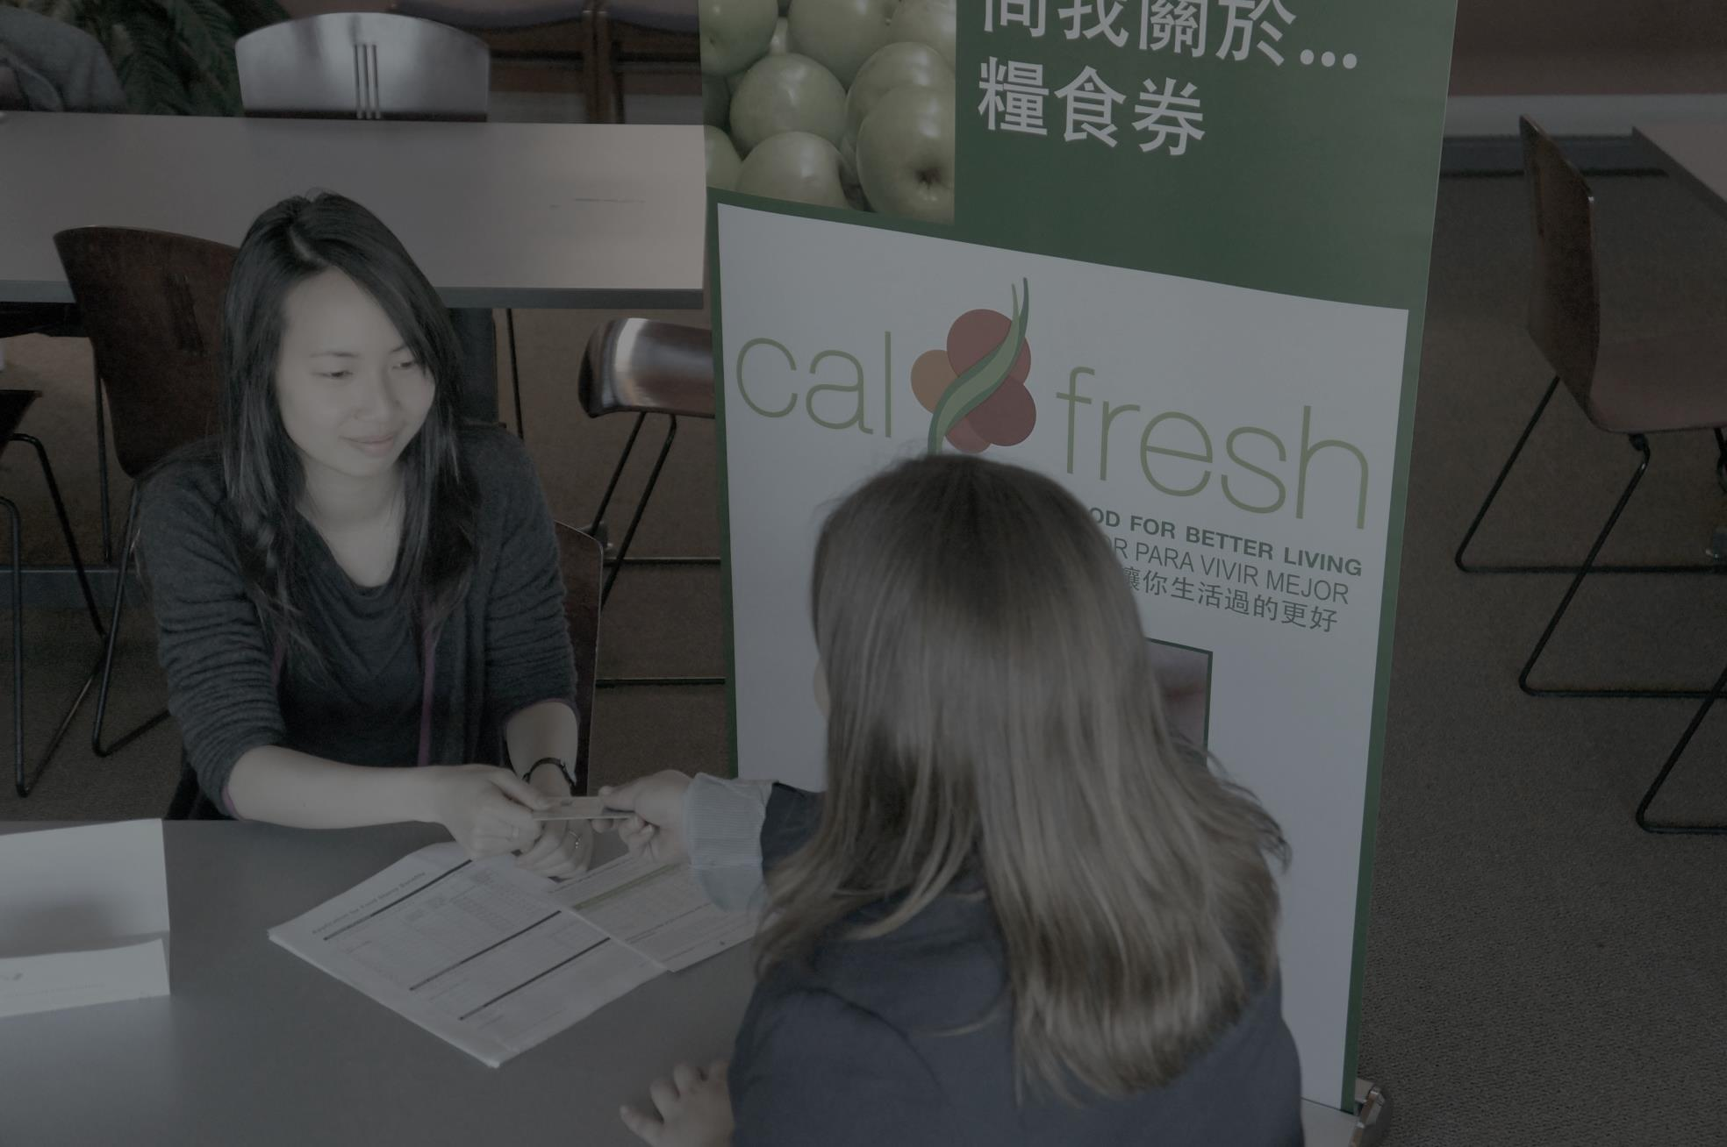
Context: Our outreach team at the Food Bank assisted with submitting 1,129 applications in San Francisco last year. The County received 23,732 applications last year.
Question: What is the experience of people applying without our help?
Collaborator: San Francisco State University Nursing School requested collaboration with ‘Community Health and Global Perspectives Theory and Practicum.’
Project: Ask nursing students to follow the CalFresh application experience of non-assisted applicants from start to finish, and observe.
Notes:
Becky

Slide 7
Project Design
Pre-Project
CalFresh App.
Process Feedback
Post-Project
Recruit likely eligible participants and gather baseline information: food security, household info, experience with benefits.
Be attentive to big things and little things while filling in and submitting the application!
Nursing students do weekly follow-up
Gather post CalFresh determination information: food security, observations
Grocery store gift cards:
Project sign-up = $20
Submit app. = $20
Complete process = $40
… $80 total!
Notes:
Becky

Slide 8
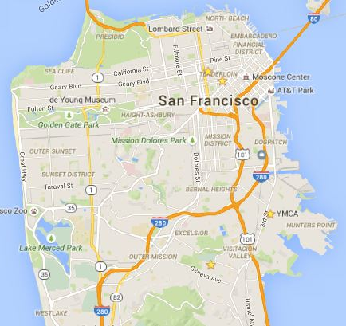
Recruiting Participants
Students were responsible for recruiting participants, with our assistance.
We recruited at food pantry sites.
Tenderloin
(Polk Senior Apts., Mercy Housing)
We recruited
15 participants
for the project!
Bayview
(YMCA)
Visitacion Valley
(Sunnydale FRC)
Notes:
Becky

Slide 9
Who Participated?
15 People
2.3
Average HH size
Notes:
Becky

Slide 10
Notes:
Becky

Slide 11
67%
Notes:
Becky

Slide 12
15 people participated.
10 submitted an application.
8 had an interview.
7 submitted documents.
6 got a determination.
5 got CalFresh.
Notes:
Ok, so those were the people who participated in our project, and I’ve told you a little bit about them.
And you might be wondering, what happened to their CalFresh applications? Did they actually get CalFresh?
So, 15 people participated, and 10 actually submitted an application. Diana will go into more detail about this in a few slides, but essentially, we had 5 people who signed up to participate in our project, but then didn’t actually submit a CalFresh application – for a variety of reasons.
Of those 10 who did submit an application, 8 people had an interview.
7 of those people also submitted verification documents,
And 6 ended up getting a final determination about whether they were eligible for CalFresh or not.
And finally, of those 6, 5 were approved and ended up getting on CalFresh.

Slide 13
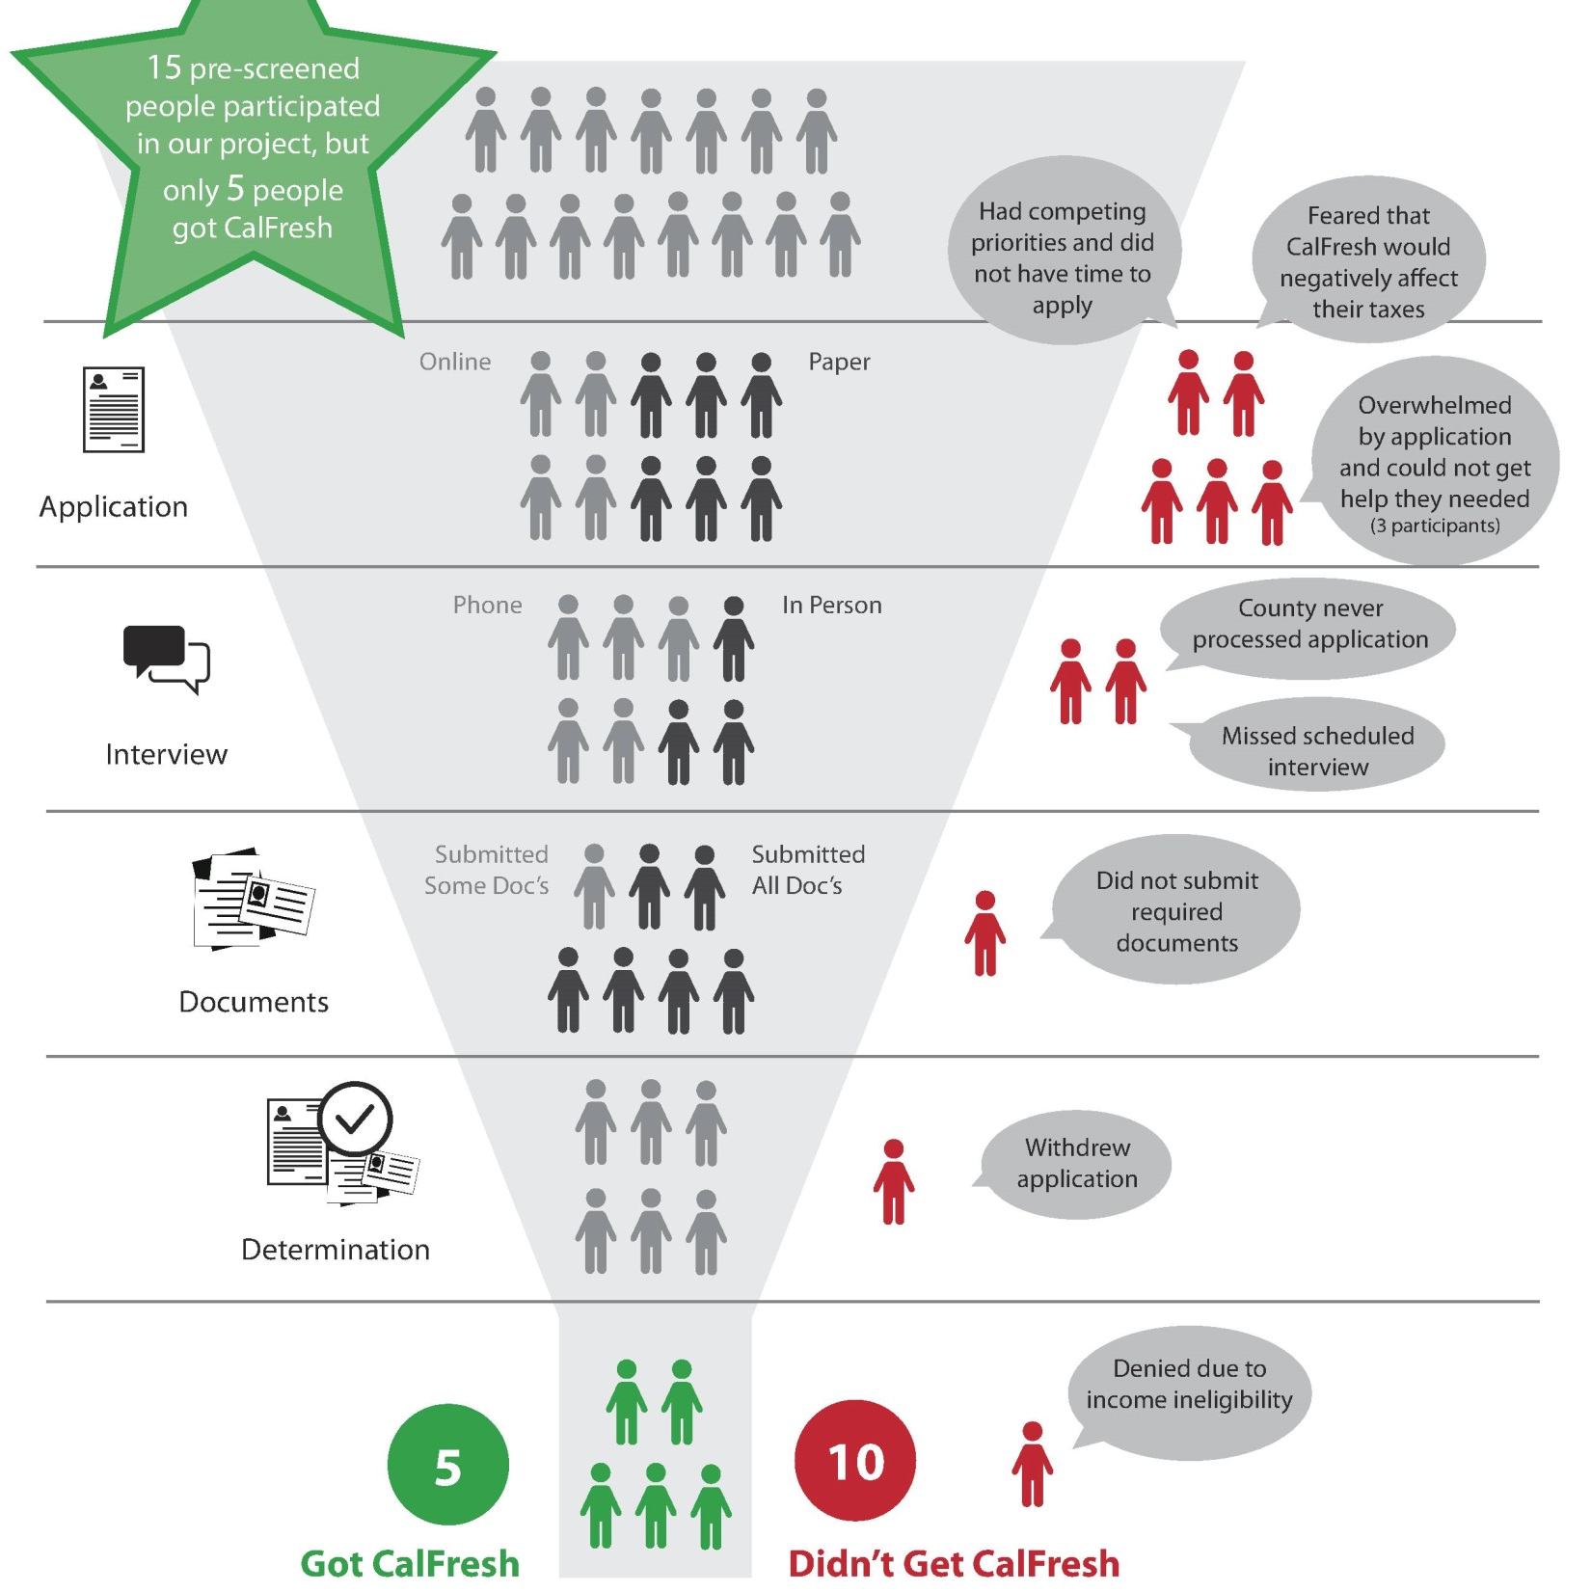
Notes:
We spent a lot of time thinking about those numbers, and what happened at various stages of the process. What we came up with is this graphic of a funnel, which shows each step of the process and where people fell out.
So there’s the application stage at the top, then the interview, then the verification documents, and then finally the determination. And you see that we start off with 15 at the top, and end up with 5 successful CalFresh recipients at the bottom. And on the right, we included little speech bubbles for why people were unsuccessful at the various stages where they fell out.
We’ve found that this visual has been really helpful as we’ve explained the project to people, and it really paints the picture of where people encounter challenges.
And so now that I’ve talked about the nuts and bolts of the project and a little bit about the results of the CAlFresh applications, I’m going to turn it over to Diana who’s going to talk about the broader themes of what we learned and how we shaped our recommendations to various agencies about how to improve the application experience.

Slide 14
What do the ‘funnel’ and participant experiences tell us about the obstacles in applying for CalFresh?
Notes:
Diana

Slide 15
1. Finding applicants was not difficult
Among potential applicants, awareness and interest were not obstacles to participation.
Notes:
Diana

Slide 16
2. Almost every single applicant encountered one or more discouraging obstacle
Example 1:
Secondary office did not accept a participant’s paper application because the staff person who handles CalFresh was on vacation.
“All the steps are confusing – going in circles… circles to nowhere… like an English garden maze.”
Example 2:
The State’s website has eligibility information that is difficult to understand.
Example 3:
One applicant was granted CalFresh benefits, then was told a few days later that she was ineligible.
“It’s incredible that professional web people were paid to make this site.”
Notes:
Diana

Slide 17
3. Most participants were already on Medi-Cal
Three quarters (11 of 15) of the project participants were already receiving Medi-Cal, but were not on CalFresh.
Notes:
Diana

Slide 18
What can we recommend as solutions
to these big and small obstacles?
Notes:
Diana

Slide 19
Connect CalFresh to Medi-Cal at every turn: Maximize dual enrollment between programs.
Locally:
Create plan for improving and tracking dual enrollment
State:
Develop guidance on allowable dual enrollment mechanisms
Track and share successful county strategies
Streamline technology for online dual applications
USDA:
Guide the State on thinking about possibilities for dual enrollment
Notes:
Diana

Slide 20
Ask, Improve, Repeat: Create a system for making improvements by soliciting, reviewing, and analyzing feedback on the enrollment experience.
Locally and State:
Develop and implement a transparent local and state system for soliciting, reviewing, and responding to feedback.
USDA:
Call on USDA to monitor counties in addressing issues.
Ask
Improve
Notes:
Diana

Slide 21
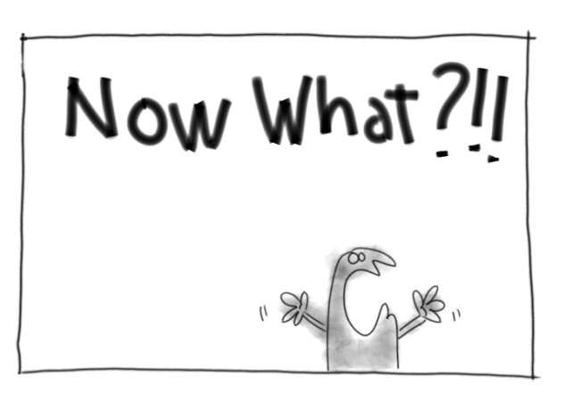
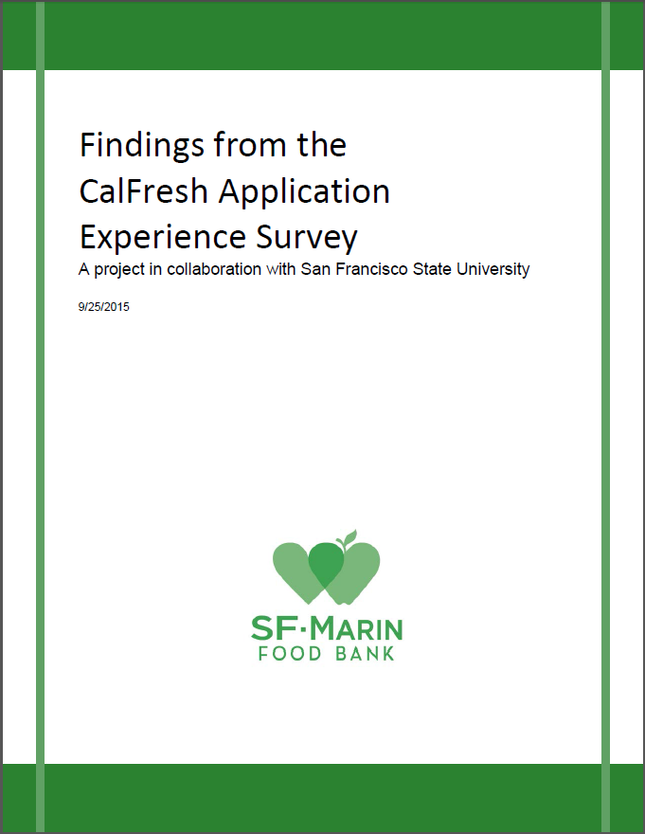
Sharing findings at all levels.
Incorporating recommendations into advocacy locally and at the state level.
Encourage replication of similar studies in other counties.
Develop ongoing mechanisms for collecting data and creating accountability.
http://www.sfmfoodbank.org/advocating-locally
Notes:
Diana

Slide 22
How can we work with our County and share what we learned?
Tiana Wertheim
Senior Analyst
SF Human Services Agency
Notes:
Diana introduces Tiana

Slide 23
The Study Offered…
A different perspective: we don’t hear from the people who don’t apply.
A safe space: applicants may be more forthcoming with CBO staff.
A good catalyst: some observations confirmed the need for improvements that HSA was already considering.
Notes:
Tiana

Slide 24
‘Feedback Loop’ Meetings
What: A productive, creative forum for discussing and piloting systemic improvements (small and large) that will ease the way for new and existing CalFresh consumers.
How often: Quarterly.
Who: SFHSA Managers( CalFresh/MediCal Program managers and the manager of Lobby Reception), Eligibility Workers, and Food Bank advocacy and CalFresh outreach staff.
Notes:
Tiana

Slide 25
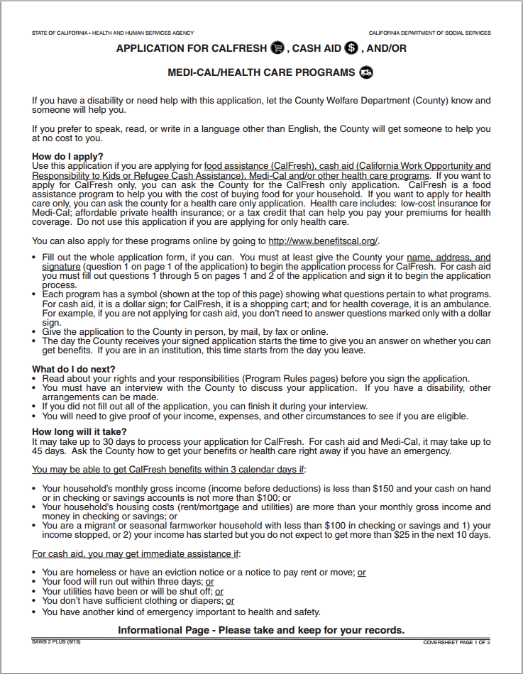
Design ‘Cover Sheet’ for Applications
Why: Clients were frustrated that the paper application didn’t include any information about where to send it or who to call if they had questions.
Process:
Discussed at feedback loop meeting.
Food Bank staff doing initial prototyping, then will gather feedback from HSA staff, then will have professional designers to design it.
Notes:
Tiana

Slide 26
Dual Enrollment Work Group
Why: SFHSA wants to restructure business process to promote and simplify dual/triple enrollment in CalFresh/Medi-Cal and CAAP. This workgroup has been tasked with making recommendations to Executive Leadership about how to do so.
Who: Program Managers from CalFresh/MediCal/CAAP, Supervisors, Eligibility Workers, Lobby Reception staff, Records Management, ADA services manager, Planners, Department of Office Innovation.
How--still deciding, but likely to include: Diagraming the enrollment/carrying processes in each program/building. Identifying opportunities to cross promote at each client touch. Providing staff scripts/role-plays. Using a default "Opt-in" strategy. (Precheck boxes on forms, compile forms of multiple programs in single packets, etc). Identifying/addressing technological barriers.
How often: Every two weeks. (We just had our second meeting.)
Seeking Professional Assistance: To figure out how to employ strategies of behavioral economics to cross promote benefits.
Notes:
Tiana

Slide 27
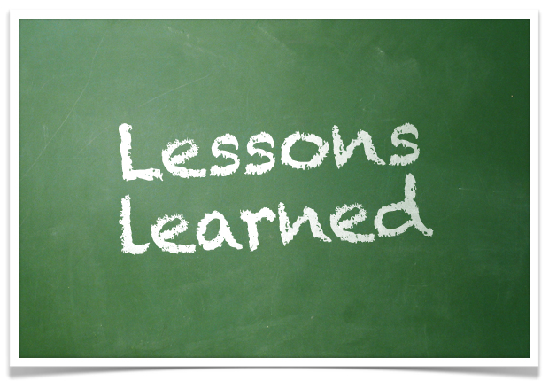
Make it a collaborative project with your county’s HSA CalFresh team.
Working with students is a good idea because they don’t know much about CalFresh themselves.
Pare down the survey questions and keep the observations/commentary more qualitative and open.
Recruit participants from places where it will be easy to connect with them every week – like a weekly food pantry.
Encourage students to apply!
Notes:
Becky

Slide 28
Thank you!
Diana Jensen
Senior Policy & Advocacy Analyst
SF-Marin Food Bank
djensen@sfmfoodbank.org
(415) 282-1900 x313
Becky Gershon
Policy & Advocacy Coordinator
SF-Marin Food Bank
bgershon@sfmfoodbank.org
(415) 282-1900 x317
Tiana Wertheim
Senior Analyst
SF Human Services Agency
tiana.wertheim@sfgov.org
(415) 558-1108
Materials will be emailed to participants and posted at:
www.transformcalfresh.org

